Slide 1
Component Diagram & Deployment Diagram

Slide 2
Introduction
Component diagram shows components, provided and required interfaces, ports, and relationships between them.
This type of diagrams is used in Component-Based Development (CBD) to describe systems with Service-Oriented Architecture (SOA).
Component-based development is based on assumptions that previously constructed components could be reused and that components could be replaced by some other "equivalent" or "conformant" components, if needed.

Slide 3
The artifacts that implement component are intended to be capable of being deployed and re-deployed independently, for instance to update an existing system.
Components in UML could represent
logical components (e.g., business components, process components), and
physical components (e.g., CORBA components, EJB components, COM+ and .NET components, WSDL components, etc.),

Slide 4
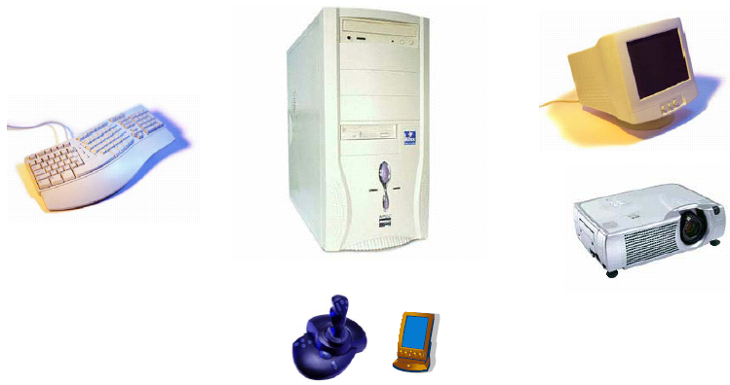
Component Diagram – another example

Slide 5
Component Diagram
Shows a set of components and their relationships.
Represents the static implementation view of a system.
Components map to one or more classes, interfaces, or collaborations.
Mapping of Components into Classes
Components and their Relationships
loanOfficer.dll
component
Registrar.exe
LoanOfficer
CreditSearch
Course.dll
LoanPolicy
Student.dll
classes
Notes:
See UML text pg. 347 (figure 25-3) for an example.

Slide 6
Component Diagram
Big demand, hmm…
Short history behind architecture
Architecture still an emerging discipline
UML and architecture evolving in parallel
Component diagram in need of better formalization and experimentation
Notes:
See UML text pg. 347 (figure 25-3) for an example.

Slide 7
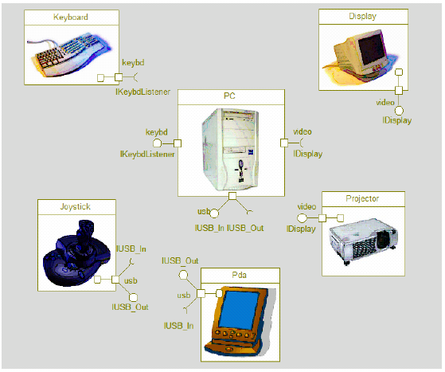
Component Diagram – another example

Slide 8
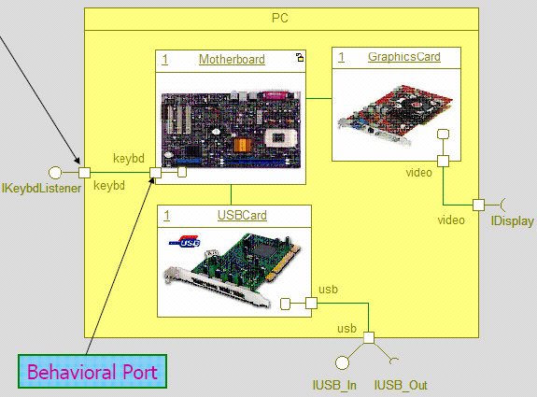
Component Diagram – another example

Slide 9
Standard Component Stereotypes
There are several standard UML stereotypes that apply to components:
«subsystem»
«process»
«service»
«specification»
«realization»
«implement»

Slide 10
Contd…
«subsystem»: Subsystem is a component representing unit of hierarchical decomposition for large systems, and is used to model large scale components.
Definitions of subsystems may vary among different domains and software methods. It is expected that domain and method profiles will specialize this element.
A subsystem may have specification and realization elements.
«process»: UML Standard Profile defines process as a transaction based component.

Slide 11
Contd…
«service»: Service is a stateless, functional component.
«specification»: Specification is a classifier that specifies a domain of objects without defining the physical implementation of those objects.
«realization»: Realization is a classifier that specifies a domain of objects and that also defines the physical implementation of those objects.

Slide 12
Component Diagram
Explicit description of interfaces:
provided services to other components
requested services from other components
Component
lollipop
Component
socket
An interface is a collection of 1..* methods, and 0..* attributes
Interfaces can consist of synchronous and / or asynchronous operations
A port (square) is an interaction point between the component and its environment.
Can be named; Can support uni-directional (either provide or require) or bi-directional (both provide and require) communication; Can support multiple interfaces.
possibly concurrent interactions
fully isolate an object’s internals from its environment
caller or callee?
security
AccessControl
StudentAdministration
Student
Encription
Incoming signals/calls
Persistence
Outgoing signals/calls
StudentSchedule
Data[1..*]
DataAccess
Notes:
See UML text pg. 347 (figure 25-3) for an example.

Slide 13
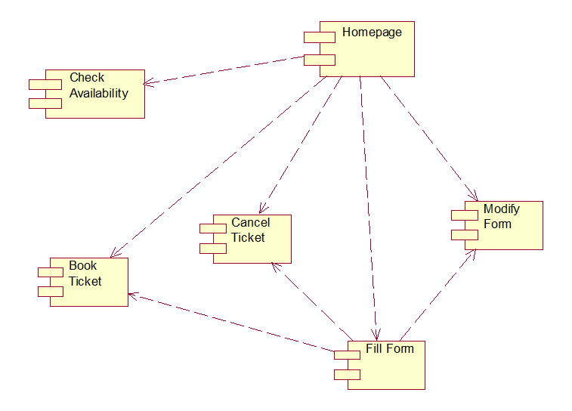
Railway reservation system

Slide 14
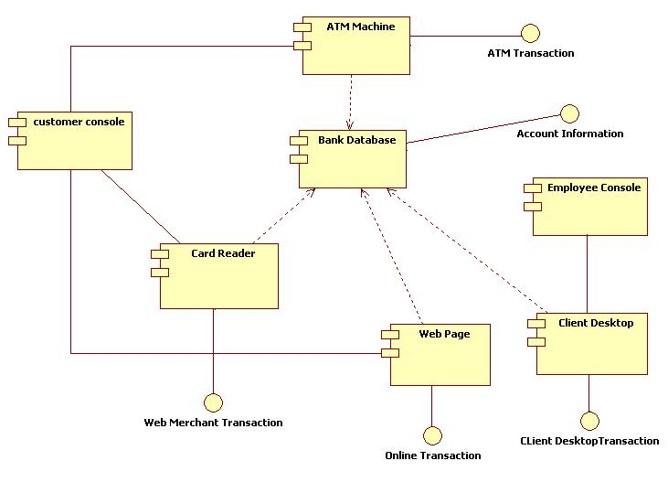
ATM

Slide 15
Deployment Diagram
A deployment diagram in the Unified Modeling Language models the physical deployment of artifacts on nodes.
To describe a web site, for example,
A deployment diagram would show what hardware components ("nodes") exist (e.g., a web server, an application server, and a database server)
what software components ("artifacts") run on each node (e.g., web application, database),
and how the different pieces are connected (e.g. JDBC, REST, RMI).

Slide 16
Contd…
The nodes appear as boxes,
and the artifacts allocated to each node appear as rectangles within the boxes.
Nodes may have subnodes, which appear as nested boxes.
A single node in a deployment diagram may conceptually represent multiple physical nodes, such as a cluster of database servers.

Slide 17
Deployment Diagram
Shows a set of processing nodes and their relationships.
Represents the static deployment view of an architecture.
Nodes typically enclose one or more components.
TCP/IP
IIS + PhP Server
TCP/IP
J2EE Server
Membership Server
DecNet
Tomcat Server

